Slide 1
Sample Size
Power and other methods

Slide 2
Non-central Chisquare

Slide 3
Non-central F distribution

Slide 4
General Linear Model
Note that the sample size is concealed in the non-centrality parameter.

Slide 5
Power
When L β ≠ h, the sample size influences the distribution of F* through two quantities:
  The denominator degrees of freedom n-p
  The non-centrality parameter ϕ
The denominator degrees of freedom also influences the critical value, but the critical value of F* settles down to the critical value of a chisquare with df=r, divided by r.
Power goes to one as n goes to infinity, as long as the null hypothesis is false. That is, the F test is consistent.

Slide 6
Comparing two means

Slide 7
H₀: L β= h

Slide 8
Non-centrality parameter is
f = n₁/n , the proportion of observations in treatment 1

Slide 9
Non-centrality Parameter
d is called effect size. The effect size specifies how wrong the null hypothesis is, by expressing the absolute difference between means in units of the common within-cell standard deviation.
The non-centrality parameter (and hence, power) depends on the three parameters μ₁, μ₂ and σ² only through the effect size d.
Power depends on sample size, effect size and an aspect of design – allocation of relative sample size to treatments. Equal sample sizes yield the highest power in the 2-sample case.

Slide 10
How to proceed
Pick an effect size you’d like to be able to detect. It should be just over the boundary of interesting and meaningful.
Pick a desired power – a probability with which you’d like to be able to detect the effect by rejecting the null hypothesis.
Start with a fairly small n and calculate the power. Increase the sample size until the desired power is reached.

Slide 11
For the 2-sample comparison
Suppose we want to be able to detect a half standard deviation difference between means with power = 0.80 at the alpha = 0.05 significance level.
Definitely use equal sample sizes.
Phi = n f (1-f) d² = n * ½ * ½ * (½)^2 = n/16

Slide 12
Two sample test with R

Slide 13
One Factor ANOVA (r means)

Slide 14
In the two-sample case, the non-centrality parameter was the product of sample size, effect size and the configuration of relative sample sizes.
Once we get beyond two groups, effect and design are mixed together in a way that's impossible to separate.
For a fixed sample size, phi (and hence power) is maximized by splitting the sample equally between the two treatments whose means are farthest apart, and giving zero observations to the other treatments.
Reluctantly, we will still call ϕ n times “effect size.”
  Even though it does not reduce to what we called effect size before, if r = 2. It’s d²/4.
  And it is “size” in a metric strongly influenced by the allocation of relative sample size to treatments.

Slide 15
Example

Slide 17
The Substitution Method
Does look familiar?
It’s the standard elementary formula for the Between-Groups sum of squares in a one-way ANOVA, except with μ values substituted for sample means.
This happens because the general formulas for F and ϕ are so similar.

Slide 18
Any re-expression of the numerator of F* in terms of the sample cell means corresponds to a re-expression of the numerator of ϕ in terms of population cell means.
So, to obtain a formula for the non-centrality parameter, all you have to do is locate a convenient formula for the F-test of interest. In the expression for the numerator sum of squares, replace sample cell means by population cell means. Then divide by σ². The result is a formula for the non-centrality parameter.
This applies to any F-test in any fixed effects factorial ANOVA.
See Scheffé (1959), page 39 for a more general version of this rule.

Slide 19
Example: a 2-factor design
For equal sample sizes I found the formula,
Which yields
Different n!

Slide 20
What is a meaningful effect size? As far as I can tell, the only solution is to make up a meaningful effect, and apply the formula to it.
In general, special purpose formulas may yield insight, but maybe not.
Locating a special-purpose formula can be time consuming.
You have to be sure of the notation, too.
It can require some calculator work or a little programming. Errors are possible.
Often, a matrix approach is better, especially if you have to make up an effect and calculate its size anyway.

Slide 21
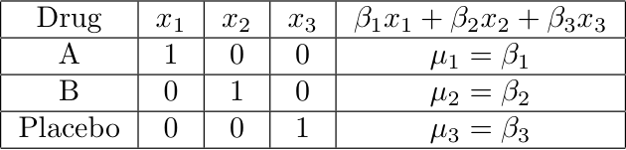
Cell means dummy variable coding: r indicators and no intercept
Test contrasts of the means: H₀: L β= 0
Notes:
This model is equivalent to the one with the intercepts

Slide 22
For designs with more than one factor
Use cell means coding with one indicator for each treatment combination.
All the usual tests are tests of contrasts.
Use

Slide 23
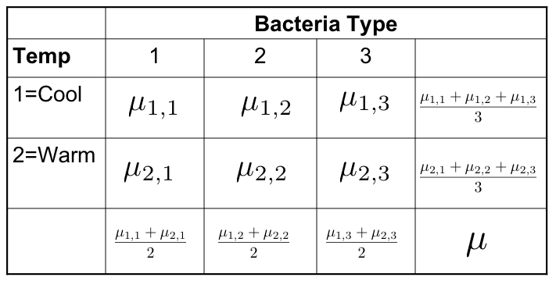
Testing Contrasts
Differences between marginal means are definitely contrasts
Interactions are also sets of contrasts

Slide 24

Interactions are sets of Contrasts

Slide 25
With cell means coding
Assume there are p treatment combinations.
The X matrix has exactly one 1 in each row, and all the rest zeros.
There are n_{j} ones in each column.

Slide 26
Multiplying and dividing by n
f₁, .. f_{r} are relative sample sizes: f_{j} = n_{j}/n
As usual, the non-centrality parameter is sample size times a quantity that we reluctantly call effect size.
Lβ is an effect -- a particular way in which the null hypothesis is wrong. It is naturally expressed in units of the common within-treatment standard deviation σ, and in general there is no reasonable way to avoid it.
Almost always, h = 0.

Slide 27
To actually do a power analysis
All you need is a vector of relative sample sizes,
The contrast matrix L
And a vector of numbers representing the differences between Lβ and h in units of σ.

Slide 28
Recall the two-factor interaction

Slide 29
An example
Cell sample sizes are all equal, and we want to be able to detect an effect of this
magnitude with probability at least 0.80.

