Slide 1
Interactions and Factorial ANOVA
STA 312 s 2019
See last slide for copyright information

Slide 2
Interactions
Interaction between explanatory variables means “It depends.”
Relationship between one explanatory variable and the response variable depends on the value of the other explanatory variable.
Can have
  Quantitative by quantitative
  Quantitative by categorical
  Categorical by categorical

Slide 3
Quantitative by Quantitative
For fixed x₂
Both slope and intercept depend on value of x₂
And for fixed x₁, slope and intercept relating x₂ to E(Y) depend
on the value of x₁

Slide 4
Quantitative by Categorical
One regression line for each category.
Interaction means slopes are not equal
Form a product of quantitative variable by each dummy variable for the categorical variable
For example, three treatments and one covariate: x₁ is the covariate and x₂, x₃ are dummy variables

Slide 5
General principle
Interaction between A and B means
  Relationship of A to Y depends on value of B
  Relationship of B to Y depends on value of A
The two statements are formally equivalent

Slide 6
Make a table
Notes:
%%%%%%%%%%%%%%%%%%%%%%
E(Y|\mathbf{x}) = \beta_0 + \beta_1 x_1 + \beta_2 x_2 + \beta_3 x_3 + \beta_4x_1x_2 + \beta_5 x_1x_3 % 30
\begin{tabular}{|c|c|c|c|} \hline
Group & $x_2$ & $x_3$ & $E(Y|\mathbf{x})$ \\ \hline
1 & 1 & 0 & $(\beta_0+\beta_2) + (\beta_1+\beta_4) x_1$ \\ \hline
2 & 0 & 1 & $(\beta_0+\beta_3) + (\beta_1+\beta_5) x_1$ \\ \hline
3 & 0 & 0 & $~~~~~\beta_0 ~~~~+ ~~~~~\beta_1 ~~~~x_1$ \\ \hline
\end{tabular}

Slide 7
What null hypothesis would you test for
Equal slopes
Comparing slopes for group one vs three
Comparing slopes for group one vs two
Equal regressions
Interaction between group and x₁

Slide 8
What to do if H₀: β₄=β₅=0 is rejected
How do you test Group “controlling” for x₁?
A reasonable choice is to set x₁ to its sample mean, and compare treatments at that point.
Notes:
This is setting up Bruce’s paradox later.

Slide 9
Categorical by Categorical
Naturally part of factorial ANOVA in experimental studies
Also applies to purely observational data

Slide 10
Factorial ANOVA
More than one categorical explanatory variable

Slide 11
Factorial ANOVA
Categorical explanatory variables are called factors
More than one at a time
Primarily for true experiments, but also used with observational data
If there are observations at all combinations of explanatory variable values, it’s called a complete factorial design (as opposed to a fractional factorial).

Slide 12
The potato study
Cases are potatoes
Inoculate with bacteria, store for a fixed time period.
Response variable is percent surface area with visible rot.
Two explanatory variables, randomly assigned
  Bacteria Type (1, 2, 3)
  Temperature (1=Cool, 2=Warm)

Slide 13
Two-factor design
 | Bacteria Type
Temp | 1 | 2 | 3
1=Cool
2=Warm
Six treatment conditions
Notes:
Call the treatment conditions “cells.”

Slide 14
Factorial experiments
Allow more than one factor to be investigated in the same study: Efficiency!
Allow the scientist to see whether the effect of an explanatory variable depends on the value of another explanatory variable: Interactions
Thank you again, Mr. Fisher.
Notes:
… And here’s our model

Slide 15






Normal with equal variance and conditional (cell) means
 | Bacteria Type
Temp | 1 | 2 | 3
1=Cool
2=Warm
Notes:
Marginal means
Grand mean

Slide 16
Tests
Main effects: Differences among marginal means
Interactions: Differences between differences (What is the effect of Factor A? It depends on the level of Factor B.)

Slide 17
To understand the interaction, plot the means

Slide 18
Either Way

Slide 19
Non-parallel profiles = Interaction
Notes:
… And her are some examples

Slide 20
Main effects for both variables, no interaction

Slide 21
Main effect for Bacteria only
Notes:
And we set up a regression equation
With products

Slide 22
Main Effect for Temperature Only

Slide 23
Both Main Effects, and the Interaction

Slide 24
Should you interpret the main effects?
Notes:
Sometimes you can -- more later

Slide 25
A common error
Categorical explanatory variable with p categories
p dummy variables (rather than p-1)
And an intercept
There are p population means represented by p+1 regression coefficients - not unique

Slide 26
But suppose you leave off the intercept
Now there are p regression coefficients and p population means
The correspondence is unique, and the model can be handy -- less algebra
Called cell means coding

Slide 27
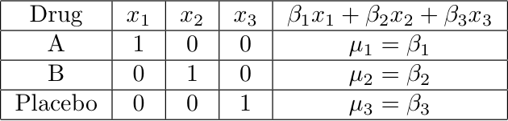
Cell means coding: p indicators and no intercept
Notes:
This model is equivalent to the one with the intercepts

Slide 28
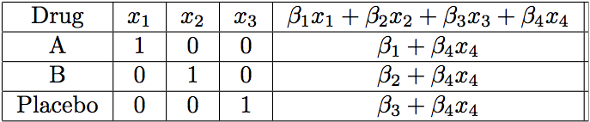
Add a covariate: x₄
Notes:
Parallel slopes
Equivalent to the model with intercept
Regression coefficients for the dummy vars are the intercepts
Easy to specify contrasts

Slide 29
Contrasts
Notes:
Linear Combination, weights
Test contrast = 0
Pairwise differences are contrasts

Slide 30
In a one-factor design
Mostly, what you want are tests of contrasts,
Or collections of contrasts.
You could do it with any dummy variable coding scheme.
Cell means coding is often most convenient.
With β=μ, test H₀: Lβ=h
Can get a confidence interval for any single contrast using the t distribution.

Slide 31
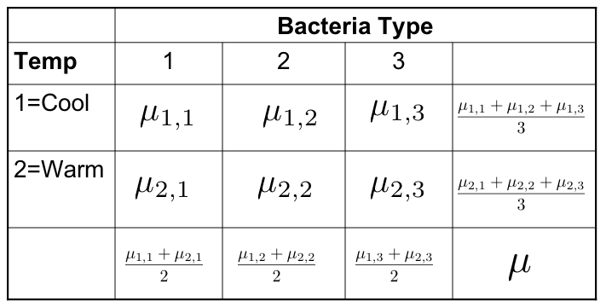
Testing Contrasts in Factorial Designs
Differences between marginal means are definitely contrasts
Interactions are also sets of contrasts

Slide 32

Interactions are sets of Contrasts
Notes:
… To understand this second one, look at the picture

Slide 33
Interactions are sets of Contrasts

Slide 34
Equivalent statements
The effect of A depends upon B
The effect of B depends on A
Notes:
… Now what happens if you add a third factor?

Slide 35
Three factors: A, B and C
There are three (sets of) main effects: One each for A, B, C
There are three two-factor interactions
  A by B (Averaging over C)
  A by C (Averaging over B)
  B by C (Averaging over A)
There is one three-factor interaction: AxBxC
Notes:
2- factor: Based on 2-d table of marginal means, averaging over the third factor.
… What does the 3-factor mean?

Slide 36
Meaning of the 3-factor interaction
The form of the A x B interaction depends on the value of C
The form of the A x C interaction depends on the value of B
The form of the B x C interaction depends on the value of A
These statements are equivalent. Use the one that is easiest to understand.

Slide 37
To graph a three-factor interaction
Make a separate mean plot (showing a 2-factor interaction) for each value of the third variable.
In the potato study, a graph for each type of potato

Slide 38
Four-factor design
Four sets of main effects
Six two-factor interactions
Four three-factor interactions
One four-factor interaction: The nature of the three-factor interaction depends on the value of the 4th factor
There is an F test for each one
And so on …

Slide 39
As the number of factors increases
The higher-way interactions get harder and harder to understand
All the tests are still tests of sets of contrasts (differences between differences of differences …)
But it gets harder and harder to write down the contrasts
Effect coding becomes easier

Slide 40
Effect coding
Like indicator dummy variables with intercept, but put -1
for the last category.
Bact | B₁ | B₂
1 | 1 | 0
2 | 0 | 1
3 | -1 | -1
Temperature | T
1=Cool | 1
2=Warm | -1
Notes:
Look at the regression equation

Slide 41
Interaction effects are products of dummy variables
The A x B interaction: Multiply each dummy variable for A by each dummy variable for B
Use these products as additional explanatory variables in the multiple regression
The A x B x C interaction: Multiply each dummy variable for C by each product term from the A x B interaction
Test the sets of product terms simultaneously
Notes:
It’s very easy to do this systematically. With contrasts, you have to think.

Slide 42
Make a table
Bact | Temp | B₁ | B₂ | T | B₁T | B₂T
1 | 1 | 1 | 0 | 1 | 1 | 0
1 | 2 | 1 | 0 | -1 | -1 | 0
2 | 1 | 0 | 1 | 1 | 0 | 1
2 | 2 | 0 | 1 | -1 | 0 | -1
3 | 1 | -1 | -1 | 1 | -1 | -1
3 | 2 | -1 | -1 | -1 | 1 | 1
Notes:
Not too fast

Slide 43





Cell and Marginal Means
 | Bacteria Type
Tmp | 1 | 2 | 3
1=C
2=W
Notes:
Marginal means
Grand mean

Slide 44
We see
Intercept is the grand mean
Regression coefficients for the dummy variables are deviations of the marginal means from the grand mean
What about the interactions?

Slide 45

A bit of algebra shows
Notes:
Similarly, if beta4=beta5=0, ….

Slide 46
Factorial ANOVA with effect coding is pretty automatic
You don’t have to make a table unless asked.
It always works as you expect it will.
Hypothesis tests are the same as testing sets of contrasts.
Covariates present no problem. Main effects and interactions have their usual meanings, “controlling” for the covariates.
Plot the “least squares means” (Y-hat at x-bar values for covariates).
Notes:
… Just to summarize

Slide 47
Again
Intercept is the grand mean
Regression coefficients for the dummy variables are deviations of the marginal means from the grand mean
Test of main effect(s) is test of the dummy variables for a factor.
Interaction effects are products of dummy variables.

Slide 48
Proportional Hazards
Notes:
$\mathbf{x}^\top \boldsymbol{\beta} = \beta_0 + \beta_1 x + \beta_2 d_1 + \beta_3 d_2 + \beta_4xd_1 + \beta_5 xd_2$ % 30
\vspace{3mm}
\renewcommand{\arraystretch}{1.5}
\begin{tabular}{|c|c|c|l|} \hline
Group & $d_1$ & $d_2$ & $h(t) = h_0(t)e^{\mathbf{x}^\top \boldsymbol{\beta}}$ \\ \hline
1 & 1 & 0 & $h_0(t)e^{(\beta_0+\beta_2) + (\beta_1+\beta_4) x}$ \\ \hline
2 & 0 & 1 & $h_0(t)e^{(\beta_0+\beta_3) + (\beta_1+\beta_5) x}$ \\ \hline
3 & 0 & 0 & $h_0(t)e^{\beta_0 + \beta_1x}$ \\ \hline
\end{tabular}
\vspace{3mm}
Hazard ratio $\frac{h_1(t)}{h_3(t)} = e^{\beta_2+\beta_4x}$ depends on $x$.
% 30 pt

Slide 49
Copyright Information
This slide show was prepared by Jerry Brunner, Department of
Statistical Sciences, University of Toronto. It is licensed under a Creative
Commons Attribution - ShareAlike 3.0 Unported License. Use
any part of it as you like and share the result freely. These
Powerpoint slides will be available from the course website:
http://www.utstat.toronto.edu/brunner/oldclass/312s19

