Slide 1
Interactions and Factorial ANOVA
STA312 Fall 2022
See last slide for copyright information

Slide 2
Interactions
Interaction between explanatory variables means “It depends.”
Relationship between one explanatory variable and the response variable depends on the value of the other explanatory variable.
Can have
  Quantitative by quantitative
  Quantitative by categorical
  Categorical by categorical

Slide 3
Quantitative by Quantitative
For fixed x₂
Both slope and intercept depend on value of x₂
And for fixed x₁, slope and intercept relating x₂ to E(Y) depend
on the value of x₁

Slide 4
Quantitative by Categorical
One regression line for each category.
Interaction means slopes are not equal
Form a product of quantitative variable by each dummy variable for the categorical variable
For example, three treatments and one covariate: x₁ is the covariate and x₂, x₃ are dummy variables

Slide 5
General principle
Interaction between A and B means
  Relationship of A to Y depends on value of B
  Relationship of B to Y depends on value of A
The two statements are formally equivalent

Slide 6
Make a table

Slide 7
Notes:
# Tri-colour scatterplot #######################################################
# Cross in data range. (Also there's truly a curve for blue.)
# This generates Cross.pdf
rm(list=ls())
set.seed(9999)
n = 50; mu = 75; sig=6
x1 = round(rnorm(n,mu,sig)); x2 = round(rnorm(n,mu,sig)); x3 = round(rnorm(n,mu,sig))
eps1 = round(rnorm(n,0,sig)); eps2 = round(rnorm(n,0,sig)); eps3 = round(rnorm(n,0,sig))
y1 = round(-mu + 2*x1 + eps1)
y2 = round(x2 + eps2); y2[x2<mu] = mu + eps2[x2<mu]
y3 = round(x3 + eps3)
X = c(x1,x2,x3); Y = c(y1,y2,y3) + 2
train = c(numeric(n)+1,numeric(n)+2,numeric(n)+3)
# X[X>100] = 100; Y[Y>100] = 100
# cbind(train,X,Y)
# group = factor(train); anova(lm(Y~group*X))
# plot(X,Y)
plot(X,Y, pch=' ',xlab=expression(x[1]))
points(x1,y1,col='red')
points(x2,y2,col='blue')
points(x3,y3,col='green')
reg1 = lm(y1~x1); lines(x1,reg1$fitted.values,col='red') #$
reg2 = lm(y2~x2); lines(x2,reg2$fitted.values,col='blue') #$
reg3 = lm(y3~x3); lines(x3,reg3$fitted.values,col='green') #$
title(expression(paste('Effect of Treatment Depends on ',x[1])))

Slide 8
What null hypothesis would you test for
Equal slopes
Comparing slopes for group one vs three
Comparing slopes for group one vs two
Equal regressions
Interaction between group and x₁

Slide 9
What about logistic regression?

Slide 10
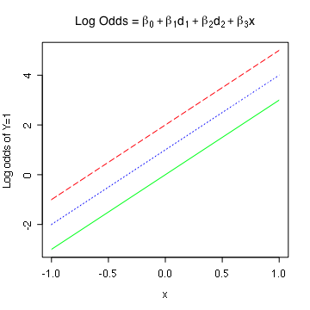
Equal slopes in the log odds scale
Notes:
X = disease severity
rm(list=ls())
b0=0; b1=1; b2=2; b3=3
xpts = seq(from=-1,to=1,by=0.05); npts = length(xpts)
zero = numeric(npts) ; one = numeric(npts)+1
x = c(xpts,xpts,xpts); d1 = c(one,zero,zero); d2 = c(zero,one,zero)
logodds = b0 + b1*d1 + b2*d2 + b3*x
# Equal slopes in the log odds
# First, plot invisible points to get right plot size
plot(x,logodds,pch=' ',ylab='Log odds of Y=1')
lines(xpts,logodds[d1==1],col='blue',lty=3)
lines(xpts,logodds[d2==1],col='red',lty=5)
lines(xpts,logodds[d1+d2==0],col='green',lty=1)
title(expression("Log Odds = " *
beta[0] + beta[1]*d[1] + beta[2]*d[2] + beta[3]*x))

Slide 11
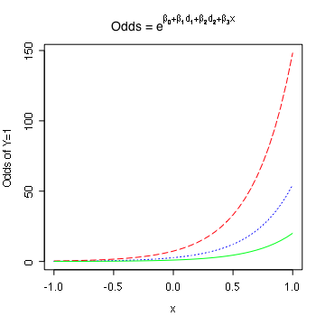
Equal slopes in the log odds scale means proportional odds
Notes:
Middle curve is e times lowest. Highest is e^2 times lowest.
# Equal slopes in the log odds scale
means proportional odds
odds = exp(logodds)
plot(x,odds,pch=' ',ylab='Odds of Y=1')
lines(xpts,odds[d1==1],col='blue',lty=3)
lines(xpts,odds[d2==1],col='red',lty=5)
lines(xpts,odds[d1+d2==0],col='green',lty=1)
title(expression("Odds = " *
e^{beta[0] + beta[1]*d[1] + beta[2]*d[2] + beta[3]*x}))

Slide 12
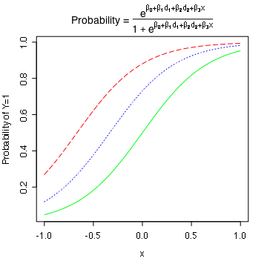
Proportional Odds in Terms of Probability
Notes:
# Proportional Odds in Terms of Probability
prob = odds/(1+odds)
plot(x,prob,pch=' ',ylab='Probability of Y=1')
lines(xpts,prob[d1==1],col='blue',lty=3)
lines(xpts,prob[d2==1],col='red',lty=5)
lines(xpts,prob[d1+d2==0],col='green',lty=1)
title(expression("Probability = " *
frac(e^{beta[0] + beta[1]*d[1] + beta[2]*d[2] + beta[3]*x},
1+e^{beta[0] + beta[1]*d[1] + beta[2]*d[2] + beta[3]*x}) ))

Slide 13
Interactions
With equal slopes in the log odds scale, differences in odds and differences in probabilities do depend on x.
Regression coefficients for product terms still mean something.
If zero, they mean that the odds ratio does not depend on the value(s) of the covariate(s).
Odds ratio has odds of Y=1 for the reference category in the denominator.
Categorical by categorical interactions are meaningful.

Slide 14
Categorical by Categorical
Naturally part of factorial ANOVA in experimental studies
Also applies to purely observational data

Slide 15
Factorial ANOVA
More than one categorical explanatory variable

Slide 16
Factorial ANOVA
Categorical explanatory variables are called factors
More than one at a time
Primarily for true experiments, but also used with observational data
If there are observations at all combinations of explanatory variable values, it’s called a complete factorial design (as opposed to a fractional factorial).

Slide 17
The potato study
Cases are potatoes
Inoculate with bacteria, store for a fixed time period.
Response variable is percent surface area with visible rot.
Two explanatory variables, randomly assigned
  Bacteria Type (1, 2, 3)
  Temperature (1=Cool, 2=Warm)

Slide 18
Two-factor design
 | Bacteria Type
Temp | 1 | 2 | 3
1=Cool
2=Warm
Six treatment conditions
Notes:
Call the treatment conditions “cells.”

Slide 19
Factorial experiments
Allow more than one factor to be investigated in the same study: Efficiency!
Allow the scientist to see whether the effect of an explanatory variable depends on the value of another explanatory variable: Interactions
Thank you again, Mr. Fisher.
Notes:
… And here’s our model

Slide 20






Normal with equal variance and conditional (cell) means
 | Bacteria Type
Temp | 1 | 2 | 3
1=Cool
2=Warm
Notes:
Marginal means
Grand mean

Slide 21
Tests
Main effects: Differences among marginal means
Interactions: Differences between differences (What is the effect of Factor A? It depends on the level of Factor B.)

Slide 22
To understand the interaction, plot the means

Slide 23
Either Way

Slide 24
Non-parallel profiles = Interaction
Notes:
… And her are some examples

Slide 25
Main effects for both variables, no interaction

Slide 26
Main effect for Bacteria only
Notes:
And we set up a regression equation
With products

Slide 27
Main Effect for Temperature Only

Slide 28
Both Main Effects, and the Interaction

Slide 29
Should you interpret the main effects?
Notes:
Sometimes you can -- more later

Slide 30
A common error
Categorical explanatory variable with k categories
p dummy variables (rather than k-1)
And an intercept
There are k population means represented by k+1 regression coefficients - not unique

Slide 31
But suppose you leave off the intercept
Now there are k regression coefficients and k population means
The correspondence is unique, and the model can be handy -- less algebra
Called cell means coding

Slide 32
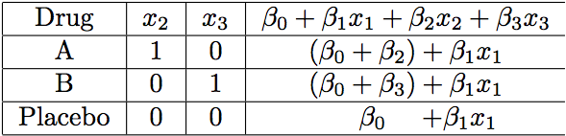

In a model with an intercept, test whether the average response to Drug A and Drug B is different from response to the placebo, controlling for age. What is the null hypothesis?
Less algebra

Slide 33
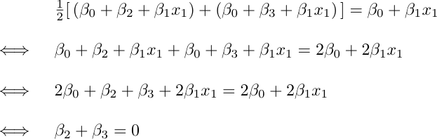
Show your work
We want to avoid this kind of thing

Slide 34
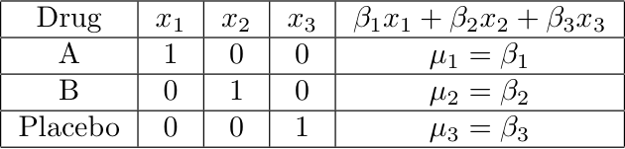
Cell means coding: k indicators and no intercept
Easy to test H₀: β₁+β₂ = 2β₃
Notes:
This model is equivalent to the one with the intercepts

Slide 35
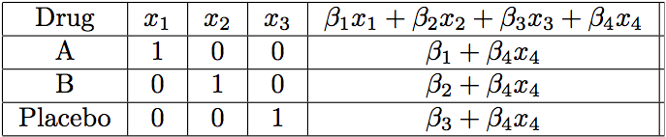
Add a covariate: x₄
Notes:
Parallel slopes
Equivalent to the model with intercept
Regression coefficients for the dummy vars are the intercepts
Easy to specify contrasts

Slide 36
Contrasts
Notes:
Linear Combination, weights
Test contrast = 0
Pairwise differences are contrasts

Slide 37
In a one-factor design
Mostly, what you want are tests of contrasts,
Or collections of contrasts.
You could do it with any dummy variable coding scheme.
Cell means coding is often most convenient.
With β=μ, test H₀: Lβ=h
Can get a confidence interval for any single contrast using the t distribution.

Slide 38
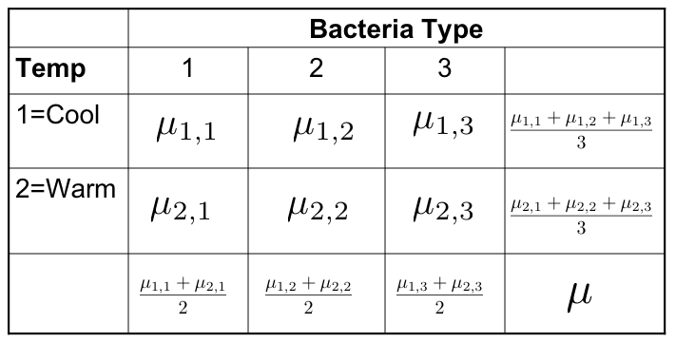
Testing Contrasts in Factorial Designs
Differences between marginal means are definitely contrasts
Interactions are also sets of contrasts

Slide 39

Interactions are sets of Contrasts
Notes:
… To understand this second one, look at the picture

Slide 40
Interactions are sets of Contrasts

Slide 41
Equivalent statements
The effect of A depends upon B
The effect of B depends on A
Notes:
… Now what happens if you add a third factor?

Slide 42
Three factors: A, B and C
There are three (sets of) main effects: One each for A, B, C
There are three two-factor interactions
  A by B (Averaging over C)
  A by C (Averaging over B)
  B by C (Averaging over A)
There is one three-factor interaction: AxBxC
Notes:
2- factor: Based on 2-d table of marginal means, averaging over the third factor.
… What does the 3-factor mean?

Slide 43
Meaning of the 3-factor interaction
The form of the A x B interaction depends on the value of C
The form of the A x C interaction depends on the value of B
The form of the B x C interaction depends on the value of A
These statements are equivalent. Use the one that is easiest to understand.

Slide 44
To graph a three-factor interaction
Make a separate mean plot (showing a 2-factor interaction) for each value of the third variable.
In the potato study, a graph for each type of potato

Slide 45
Four-factor design
Four sets of main effects
Six two-factor interactions
Four three-factor interactions
One four-factor interaction: The nature of the three-factor interaction depends on the value of the 4th factor
There is an F test for each one
And so on …

Slide 46
As the number of factors increases
The higher-way interactions get harder and harder to understand
All the tests are still tests of sets of contrasts (differences between differences of differences …)
But it gets harder and harder to write down the contrasts
Effect coding becomes easier

Slide 47
Effect coding
Like indicator dummy variables with intercept, but put -1
for the last category.
Bact | B₁ | B₂
1 | 1 | 0
2 | 0 | 1
3 | -1 | -1
Temperature | T
1=Cool | 1
2=Warm | -1
Notes:
Look at the regression equation

Slide 48
Interaction effects are products of dummy variables
The A x B interaction: Multiply each dummy variable for A by each dummy variable for B
Use these products as additional explanatory variables in the multiple regression
The A x B x C interaction: Multiply each dummy variable for C by each product term from the A x B interaction
Test the sets of product terms simultaneously
Notes:
It’s very easy to do this systematically. With contrasts, you have to think.

Slide 49
Make a table
Bact | Temp | B₁ | B₂ | T | B₁T | B₂T
1 | 1 | 1 | 0 | 1 | 1 | 0
1 | 2 | 1 | 0 | -1 | -1 | 0
2 | 1 | 0 | 1 | 1 | 0 | 1
2 | 2 | 0 | 1 | -1 | 0 | -1
3 | 1 | -1 | -1 | 1 | -1 | -1
3 | 2 | -1 | -1 | -1 | 1 | 1
Notes:
Not too fast

Slide 50





Cell and Marginal Means
 | Bacteria Type
Tmp | 1 | 2 | 3
1=C
2=W
Notes:
Marginal means
Grand mean

Slide 51
We see
Intercept is the grand mean
Regression coefficients for the dummy variables are deviations of the marginal means from the grand mean
What about the interactions?

Slide 52

A bit of algebra shows
Notes:
Similarly, if beta4=beta5=0, ….

Slide 53
What are “effects?”
There are 3 main effects for Bacteria Type: beta1, beta2 and -beta1 -beta2.
They are deviations of the marginal means from the grand mean.
There are 2 main effects for Temperature: beta3 and - beta3
They are deviations of the marginal means from the grand mean.
There are 6 interaction effects.
They are deviations of the cell mean from the grand mean plus the main effects.
They add to zero across rows and across columns.
The non-redundant ones are beta4 and beta5.
This is regression notation. There are ANOVA notations as well.

Slide 54
Factorial ANOVA with effect coding is pretty automatic
You don’t have to make a table unless asked.
It always works as you expect it will.
Hypothesis tests are the same as testing sets of contrasts.
Covariates present no problem. Main effects and interactions have their usual meanings, “controlling” for the covariates.
Plot the “least squares means” (Y-hat at x-bar values for covariates).
Notes:
… Just to summarize

Slide 55
Again
Intercept is the grand mean
Regression coefficients for the dummy variables are deviations of the marginal means from the grand mean
Test of main effect(s) is test of the dummy variables for a factor.
Interaction effects are products of dummy variables.
Notes:
Don’t forget the rotten potatoes with R from 2012. Put it in a separate document.

Slide 56
Copyright Information
This slide show was prepared by Jerry Brunner, Department of
Statistical Sciences, University of Toronto. It is licensed under a Creative
Commons Attribution - ShareAlike 3.0 Unported License. Use
any part of it as you like and share the result freely. These
Powerpoint slides will be available from the course website:
http://www.utstat.toronto.edu/brunner/oldclass/312f22

