Slide 1
Factorial ANOVA
STA305 Spring 2014
More than one categorical explanatory variable
See last slide for copyright information

Slide 2
Optional Background Reading
Chapter 7 of Data analysis with SAS

Slide 3
Factorial ANOVA
More than one categorical explanatory variable.
Categorical explanatory variables are called factors.
More than one at a time
If there are observations at all combinations of explanatory variable values, it’s called a complete factorial design (as opposed to a fractional factorial).

Slide 4
The potato study
Cases are potatoes
Inoculate with bacteria, store for a fixed time period.
Response variable is rotten surface area in mm.
Two explanatory variables, randomly assigned
Bacteria Type (1, 2, 3)
Temperature (1=Cool, 2=Warm)

Slide 5
Two-factor design
 | Bacteria Type
Temp | 1 | 2 | 3
1=Cool
2=Warm
Six treatment conditions
Notes:
Call the treatment conditions “cells.”

Slide 6
Factorial experiments
Allow more than one factor to be investigated in the same study: Efficiency!
Allow the scientist to see whether the effect of an explanatory variable depends on the value of another explanatory variable: Interactions
Thank you again, Mr. Fisher.
Notes:
… And here’s our model

Slide 7
Normal with equal variance and conditional (cell) means
 | Bacteria Type
Temp | 1 | 2 | 3
1=Cool
2=Warm
Notes:
Marginal means
Grand mean

Slide 8
Tests
Main effects: Differences among marginal means
Interactions: Differences between differences (What is the effect of Factor A? It depends on the level of Factor B.)

Slide 9
To understand the interaction, plot the means

Slide 10
Either Way

Slide 11
Non-parallel profiles = Interaction
Notes:
… And her are some examples

Slide 12
Main effects for both variables, no interaction

Slide 13
Main effect for Bacteria only
Notes:
And we set up a regression equation
With products

Slide 14
Main Effect for Temperature Only

Slide 15
Both Main Effects, and the Interaction

Slide 16
Should you interpret the main effects?
Notes:
Sometimes you can -- more later

Slide 17
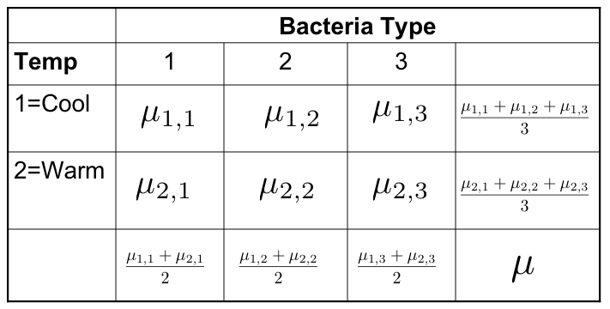
Testing Contrasts
Differences between marginal means are definitely contrasts
Interactions are also sets of contrasts

Slide 18
Interactions are sets of Contrasts
Notes:
… To understand this second one, look at the picture

Slide 19
Interactions are sets of Contrasts

Slide 20
Equivalent statements
The effect of A depends upon B
The effect of B depends on A
Notes:
… Now what happens if you add a third factor?

Slide 21
Three factors: A, B and C
There are three (sets of) main effects: One each for A, B, C
There are three two-factor interactions
A by B (Averaging over C)
A by C (Averaging over B)
B by C (Averaging over A)
There is one three-factor interaction: AxBxC
Notes:
2- factor: Based on 2-d table of marginal means, averaging over the third factor.
… What does the 3-factor mean?

Slide 22
Meaning of the 3-factor interaction
The form of the A x B interaction depends on the value of C
The form of the A x C interaction depends on the value of B
The form of the B x C interaction depends on the value of A
These statements are equivalent. Use the one that is easiest to understand.

Slide 23
To graph a three-factor interaction
Make a separate mean plot (showing a 2-factor interaction) for each value of the third variable.
In the potato study, a graph for each type of potato

Slide 24
Four-factor design
Four sets of main effects
Six two-factor interactions
Four three-factor interactions
One four-factor interaction: The nature of the three-factor interaction depends on the value of the 4th factor
There is an F test for each one
And so on …

Slide 25
As the number of factors increases
The higher-way interactions get harder and harder to understand
All the tests are still tests of sets of contrasts (differences between differences of differences …)
But it gets harder and harder to write down the contrasts
Effect coding becomes easier

Slide 26
Effect coding
Bact | B₁ | B₂
1 | 1 | 0
2 | 0 | 1
3 | -1 | -1
Temperature | T
1=Cool | 1
2=Warm | -1
Notes:
Look at the regression equation

Slide 27
Interaction effects are products of dummy variables
The A x B interaction: Multiply each dummy variable for A by each dummy variable for B
Use these products as additional explanatory variables in the multiple regression
The A x B x C interaction: Multiply each dummy variable for C by each product term from the A x B interaction
Test the sets of product terms simultaneously
Notes:
It’s very easy to do this systematically. With contrasts, you have to think.

Slide 28
Make a table
Bact | Temp | B₁ | B₂ | T | B₁T | B₂T
1 | 1 | 1 | 0 | 1 | 1 | 0
1 | 2 | 1 | 0 | -1 | -1 | 0
2 | 1 | 0 | 1 | 1 | 0 | 1
2 | 2 | 0 | 1 | -1 | 0 | -1
3 | 1 | -1 | -1 | 1 | -1 | -1
3 | 2 | -1 | -1 | -1 | 1 | 1
Notes:
Not too fast

Slide 29
Cell and Marginal Means
 | Bacteria Type
Tmp | 1 | 2 | 3
1=C
2=W
Notes:
Marginal means
Grand mean

Slide 30
We see
Intercept is the grand mean
Regression coefficients for the dummy variables are deviations of the marginal means from the grand mean
What about the interactions?

Slide 31
A bit of algebra shows
Notes:
Similarly, if beta4=beta5=0, ….

Slide 32
Factorial ANOVA with effect coding is pretty automatic
You don’t have to make a table unless asked.
It always works as you expect it will.
Hypothesis tests are the same as testing sets of contrasts.
Notes:
… Just to summarize

Slide 33
Again
Intercept is the grand mean.
Regression coefficients for the dummy variables are deviations of the marginal means from the grand mean.
Test of main effect(s) is test of the dummy variables for a factor.
Interaction effects are products of dummy variables.

Slide 34
Balanced vs. Unbalanced Experimental Designs
Balanced design: Cell sample sizes are proportional (maybe equal).
Explanatory variables have zero relationship to one another.
Numerator SS in ANOVA are independent (because contrasts are orthogonal).
Everything is nice and simple
Most experimental studies are designed this way.
As soon as somebody drops a test tube, it’s no longer balanced.

Slide 35
Analysis of unbalanced data
When explanatory variables are related, there is potential ambiguity.
A is related to Y, B is related to Y, and A is related to B.
Who gets credit for the portion of variation in Y that could be explained by either A or B?
With a regression approach, whether you use contrasts or dummy variables (equivalent), the answer is nobody.
Think of full, reduced models.
Equivalently, general linear test

Slide 36
Some software is designed for balanced data
The special purpose formulas are much simpler.
Very useful in the past.
Since most data are at least a little unbalanced, a recipe for trouble.
Most textbook data are balanced, so they cannot tell you what your software is really doing.
R’s anova and aov functions are designed for balanced data, though anova applied to lm objects can give you what you want if you use it with care.
SAS proc glm is much more convenient. SAS proc anova is for balanced data.
Notes:
We will be alert for this issue.

Slide 37
Copyright Information
This slide show was prepared by Jerry Brunner, Department of
Statistics, University of Toronto. It is licensed under a Creative
Commons Attribution - ShareAlike 3.0 Unported License. Use
any part of it as you like and share the result freely. These
PowerPoint slides will be available from the course website:
http://www.utstat.toronto.edu/brunner/oldclass/305s14

