Slide 1
STA302: Regression Analysis
See last slide for copyright information

Slide 2
Statistics
Objective: To draw reasonable conclusions from noisy numerical data
Entry point: Study relationships between variables

Slide 3
Data File
Rows are cases
Columns are variables

Slide 4
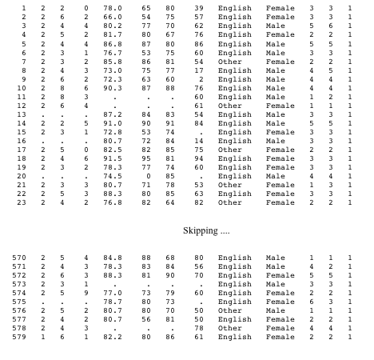
Notes:
id course precalc calc gpa calculus english mark lang $ sex $
nation1 nation2 sample;

Slide 5
Variables can be
Independent: Predictor or cause (contributing factor)
Dependent: Predicted or effect
Notes:
DV Make a claim, IV age gender make of car ever made a claim before
DV lesion size, IV type of fungus, type of plant, time

Slide 6
Simple regression and correlation
Simple means one IV
DV quantitative
IV usually quantitative too

Slide 7
Simple regression and correlation
High School GPA | University GPA
88 | 86
78 | 73
87 | 89
86 | 81
77 | 67
… | …

Slide 8
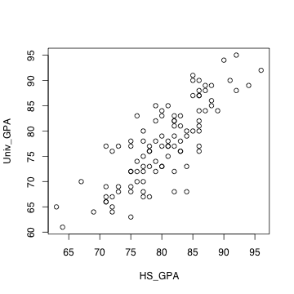
Scatterplot

Slide 9
Least squares line
Notes:
Least squared sum of squared vertical distances
Residuals represent over, under prediction
More later
Correlation coefficient measures how tightly points are clustered around the
least squares line

Slide 10
Correlation coefficient r
-1 ≤ r ≤ 1
r = +1 indicates a perfect positive linear relationship. All the points are exactly on a line with a positive slope.
r = -1 indicates a perfect negative linear relationship. All the points are exactly on a line with a negative slope.
r = 0 means no linear relationship (curve possible). Slope of least squares line = 0
r² = proportion of variation explained

Slide 11
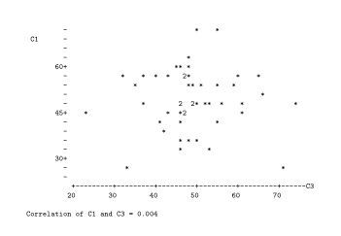
r = 0.004

Slide 12
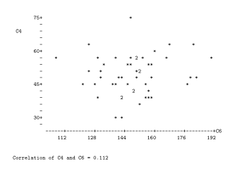
r = 0.112

Slide 13
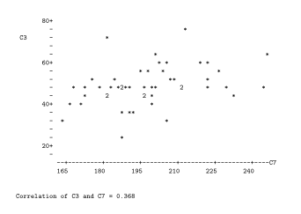
r = 0.368

Slide 14
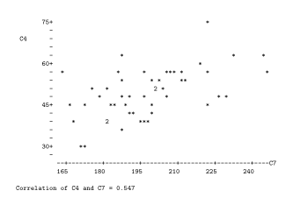
r = 0.547

Slide 15
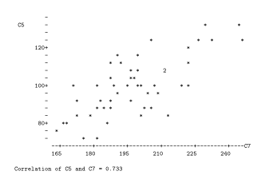
r = 0.733

Slide 16
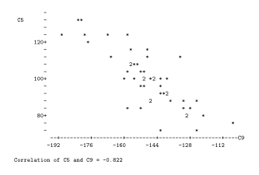
r = - 0.822

Slide 17
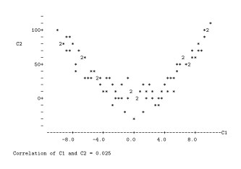
r = 0.025
Notes:
Curvilinear, NOT nonlinear

Slide 18
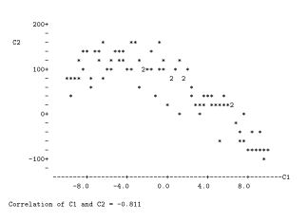
r = - 0.811
Notes:
Curvilinear relationship does not imply zero correlation

Slide 19
Why -1 ≤ r ≤ 1 ?
Notes:
r = \frac{\sum_{i=1}^n (X_i-\overline{X})(Y_i-\overline{Y})}
{\sqrt{\sum_{i=1}^n (X_i-\overline{X})^2 \sum_{i=1}^n (Y_i-\overline{Y})^2}} % 32
\cos(\theta) &=& \frac{\mathbf{a}^\prime \mathbf{b}}
{|\mathbf{a}|~|\mathbf{b}|} \\
&=& \frac{\mathbf{a}^\prime \mathbf{b}}
{\sqrt{\mathbf{a}^\prime\mathbf{a}~\mathbf{b}^\prime\mathbf{b}}} % 32

Slide 20
One Independent Variable at a Time Can Produce Misleading Results
The standard elementary tests all have a single independent variable, so they should be used with caution in practice.
Example: Artificial and extreme, to make a point
Suppose the correlation between Age and Strength is r = -0.96

Slide 21
Notes:
rm(list=ls())
rmvn <- function(nn,mu,sigma)
# Returns an nn by kk matrix, rows are independent MVN(mu,sigma)
{
kk <- length(mu)
dsig <- dim(sigma)
if(dsig[1] != dsig[2]) stop("Sigma must be square.")
if(dsig[1] != kk) stop("Sizes of sigma and mu are inconsistent.")
ev <- eigen(sigma,symmetric=T)
sqrl <- diag(sqrt(ev$values))
PP <- ev$vectors
ZZ <- rnorm(nn*kk) ; dim(ZZ) <- c(kk,nn)
rmvn <- t(PP%*%sqrl%*%ZZ+mu)
rmvn
}# End of function rmvn
set.seed(9999)
n = 100 # Each
S0 = rbind(c(1.00,9.60),
c(9.60,144.0))
chimps = rmvn(n,c(5.5,300),S0)
humans = rmvn(n,c(17.5,100),S0)
Age = c(chimps[,1],humans[,1])
Strength = c(chimps[,2],humans[,2])
plot(Age,Strength,pch=' ')
title("Age and Strength")
points(chimps,pch='*'); points(humans,pch='o')
# summary(lm(Strength~Age))
x = c(2,20); y = 383.8795 - 16.1797 * x
lines(x,y)
text(9,300,"Chimps",font=2); text(14,100,"Humans",font=2)

Slide 22
Need multiple regression

Slide 23
Copyright Information
This slide show was prepared by Jerry Brunner, Department of Statistical Sciences, University of Toronto. It is licensed under a Creative Commons Attribution - ShareAlike 3.0 Unported License. Use any part of it as you like and share the result freely. These Powerpoint slides are available from the course website:
http://www.utstat.toronto.edu/~brunner/oldclass/302f13

